Slide 1
OpenNEX

Slide 2
High Level Idea
Social Network
Data, Software, Workflow Sharing
Workflow Recommendation and Execution
Access Control
Project Management

Slide 3
Approach
Apply International Standard SOA-RA as the basis for overall architectural design
Extensibility, Portability, Reusability
Separate features into independent APIs
AWS as background

Slide 4
SOA - RA
Consumer layer (Web interface, Cache, Presentation View)
Business Process layer (Service collaboration, Adapters)
Integration layer (Enterprise Service bus)
Quality of Service layer (NFR- Scaling, Security, Availability, KPIs)
Information Layer (Data Aggregator, Data Mining)
Governance layer (Service Manager, Business Rules Manager)
Services layer (Rest API, Input/Output Transformation)
Service component layer (Publish, Invoke, Registry)
Operational systems layer (AWS)

Slide 5
Main Components
Shared Data
Shared Software
Shared Workflows
Manage Computing Power
Access Control
Social Network
Project Management

Slide 6
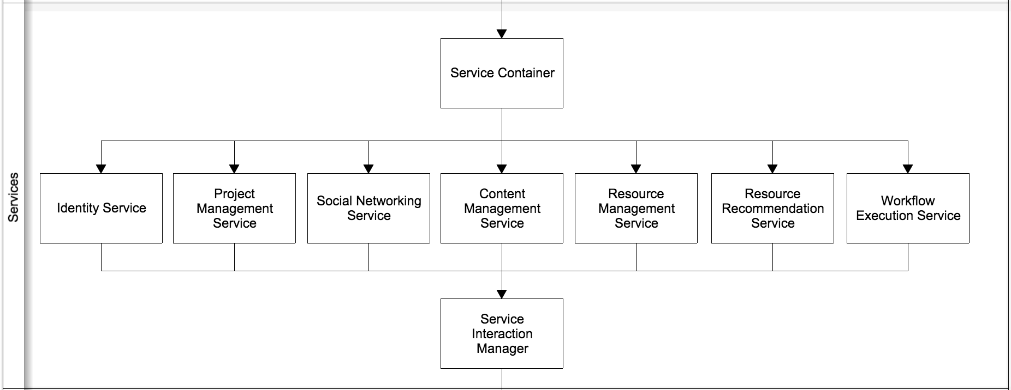
Services

Slide 7
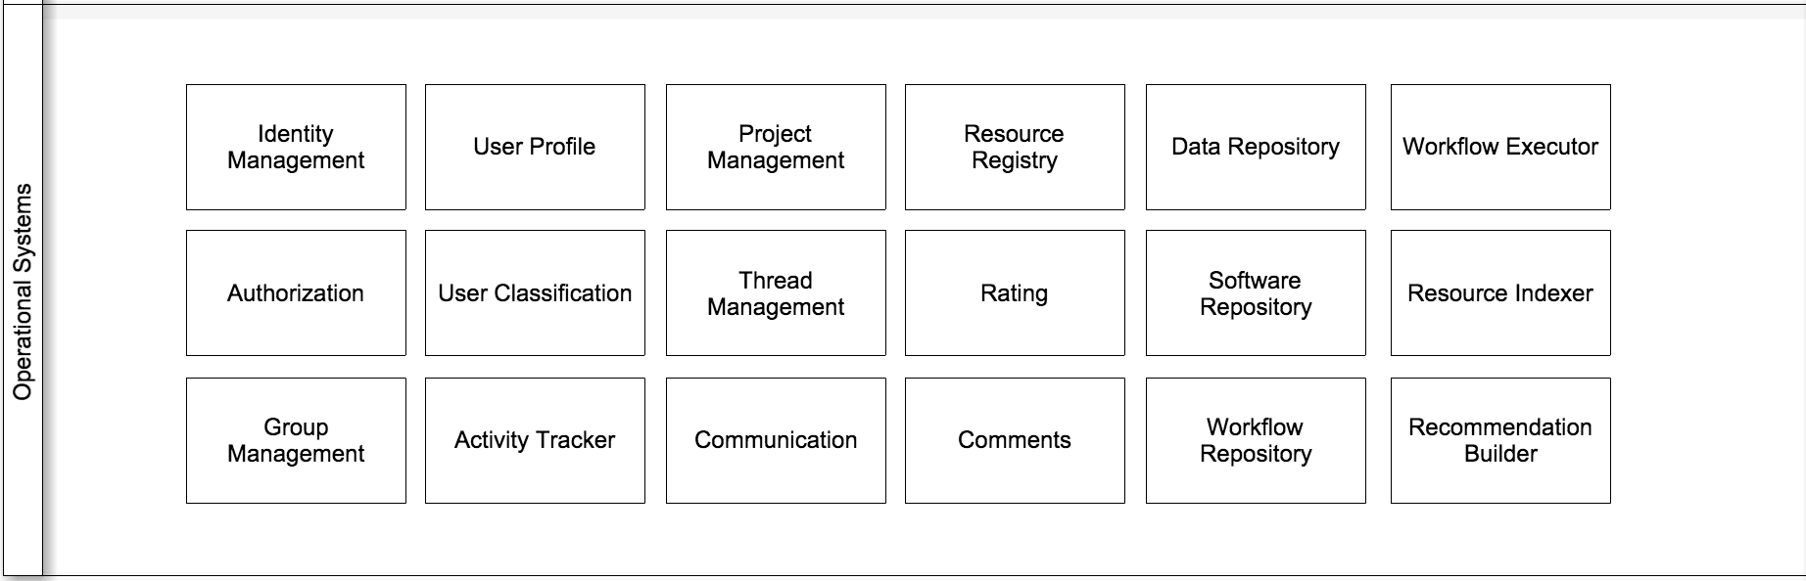
Operational Systems

Slide 8
Key Features

Slide 9
Social Networking
Built for scientists from the ground up.
Helps users connect to groups and projects
Provides a gateway to the rest of NEX’s services
External social network integration provided but optional

Slide 10
Project Management
Provides a platform for users to manage their projects
Organize users from the social network
Gives access to shared data, files and discussions for the project

Slide 11
Flexible Sharing
Flexible ways of sharing software
RESTful API
User can publish their self-hosting software with RESTful API and corresponding interface/configuration instructions with parsable format
Downloadable software
User can also upload their executable software files and environment configurations

Slide 12
Community-based Cooperation
New concepts of cooperations
Workflow creation
Base on software and other workflow
Workflow execution
Workflow parser and execution unit
Dependency notification
User notifications of related software/workflow
Progress/insight sharing
More social network interaction

Slide 13
Access Control
User login
Content ACLs
Project / Group Resource Sharing

Slide 14
Workflow Recommendation
Resource metadata indexing
Recommendation based on
Workflow Metadata
User Profiles
User Activity
Rating and Feedback
Suggest optimal configuration for workflow

Slide 15
Workflow Execution (Ideas)
Prototyping Sandbox
Processes turned into reusable APIs
Migratable dockers
Execute closer to data

